Slide 1

ROYAL HOmes KING COUNTY Housing LINEAR REGRESSION ANALYSIS By Natalya Doris

Slide 2

Business Problem
Real estate company Royal Homes is looking to better understand the King County housing market before they open up shop.
We seek to answer the following questions on behalf of Royal Homes: what types of homes should they be looking to sell to make the most profit? What features lend towards higher sale prices?

Slide 3

THE Data
This project uses the King County House Sales dataset, which includes the following columns, among others:
‘price’: sale price
'waterfront': whether the house is on the waterfront
'view': quality of view from house
'condition': how good the overall condition of the house is; related to maintenance of house
'zipcode': ZIP Code used by the USPS
'sqft_living': sq. ft. of living space

Slide 4
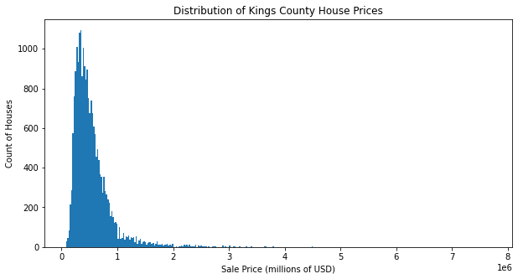

Slide 5

The Model
To better understand how various attributes of a home influence sale price, we perform a multiple linear regression model with the King County data. We determine that sq. ft. of living space, zip code, waterfront status, view and condition are among the most influential factors in determining sale price.
Notes:
Image source: https://www.newhomesource.com/learn/how-to-choose-the-right-neighborhood/

Slide 6
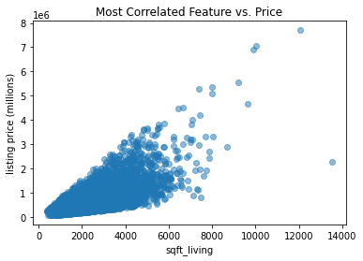
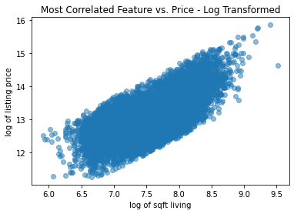
Model Selection

Slide 7
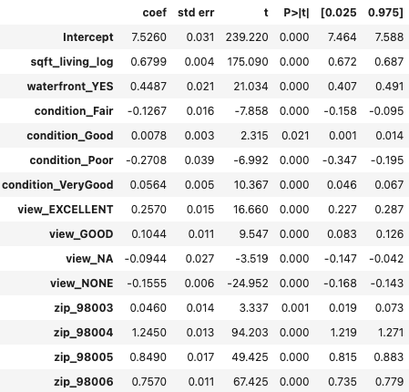
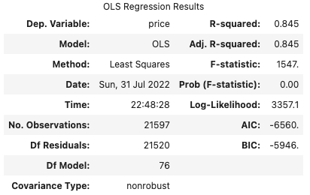
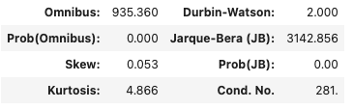
Model Results

Slide 8

Recommendations
Find properties of larger size in advantageous zip codes
Waterfront properties and properties with good views sell at higher prices
Condition matters. A house in poor condition will yield a lower sale price
Notes:
Image source: https://money.usnews.com/loans/mortgages/articles/when-house-hunting-how-to-assess-a-neighborhood

Slide 9
NEXT STEPS
Do a deep dive on top zip codes – what attributes do these houses most commonly feature?
Find data that breaks down ‘view’ into more specific categories – water view vs city view vs greenery, for example
Gather data on sales in more recent years – are there any attributes that are more impactful on sale price now?

